Slide 1



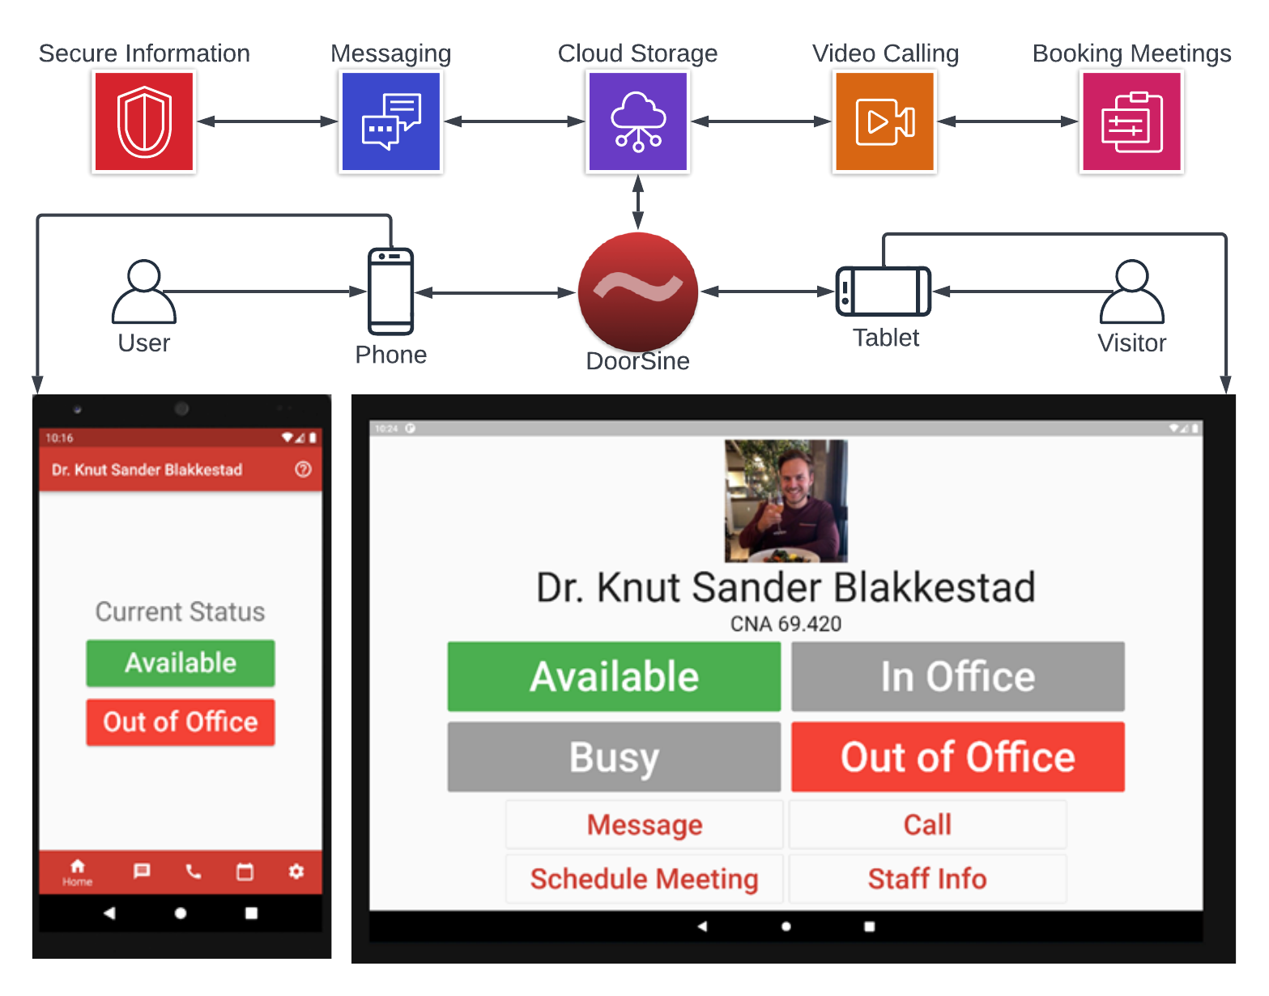
DoorSine™
Knut Sander Blakkestad with Dr. Shoaib Jameel
Intelligent Industry Ready Conversational System

